Slide 1

Semi-strucured data

Slide 2

Introduction
Social media platforms have become integral parts of our daily lives, connecting people and facilitating various interactions. This project aims to design and implement a social media database using a semi-structured approach, allowing flexibility in content and accommodating dynamic user profiles, posts, and interactions.

Slide 3
In order to design a social media database using semi-structured and structured data,
First, we must provide a simplified definition of structured data and semi-structured data
structured data :
semi-structured data :
Structured data refers to information that adheres to a formal, pre-defined data model or schema. This includes data stored in rigid tabular formats such as SQL database tables or Excel spreadsheets. Every column has precise data types like string, number, or date. The schema defines relationships and does not frequently change. Querying the neatly organized data can be optimized using indexes.
semi-structured data lacks a strict schema but still retains some organizational structure. It allows for flexibility in data representation, enabling the storage of varying types and formats of data within the same data store. Semi-structured data often utilizes formats like JSON (JavaScript Object Notation), XML (eXtensible Markup Language). This flexibility is particularly advantageous in scenarios where data schemas may evolve over time or where the data structure is inherently dynamic, such as in social media platforms

Slide 4
Designing and implementing a social media database using semi-structured data allows flexibility, scalability and efficient handling of various types of content
We have therefore implemented the scheme designed in MongoDB, ensuring effective indexing to query and manipulate semi-structured data.
Definition :
MongoDB is a NoSQL database that is often used in web development,
MongoDB offers advantages in terms of flexibility, scalability, and query capabilities. However, it's important to weigh these benefits against the learning curve and potential differences in how data is handled compared to traditional relational databases.

Slide 5
Creating a website using MongoDB, Python, involves building a full-stack web application where MongoDB serves as the database, Python for backend development, and Node.js for the server-side runtime environment
Set up MongoDB: Install MongoDB on your local machine or use a cloud-based MongoDB service like MongoDB Atlas. Make sure MongoDB is running and accessible.Choose a Python web framework: There are many Python web frameworks available, such as Flask, Django, and FastAPI. For simplicity, we used Flask.
Installing Flask and PyMongo: Flask is a lightweight web framework for Python, and PyMongo is a MongoDB driver for Python.
Install them using pip:
pip install Flask
Install pymongo to interact with MongoDB from Python:
pip install pymongos

Slide 6
If you want to install MongoDB, you can follow these general steps. Keep in mind that the specific instructions may vary slightly depending on the operating system and version you are using:
1. Choose your operating system: MongoDB supports different operating systems including Windows, macOS, and Linux.
2. Download MongoDB: Visit the official MongoDB website (https://www.mongodb.com/try/download/community) and download the appropriate installer for your operating system.
3. Install MongoDB on Windows:
- After downloading the installer, double-click it to start the installation process.
- Follow the prompts in the installation wizard. You can choose the installation directory
and whether to install MongoDB Compass (the GUI tool for MongoDB).

Slide 7
4. Verify installation: After installation, you can verify that MongoDB is installed correctly by opening a terminal or command prompt and running the mongod command. This starts the MongoDB server by mongod.exe from the bin directory of the MongoDB installation path.
5. Get started with MongoDB: Once MongoDB is installed and running, you can interact with it using MongoDB Shell (mongo) or through various MongoDB client applications and libraries.
It is important to refer to the official MongoDB documentation for detailed installation instructions specific to your operating system and version. Additionally, always make sure to download MongoDB from a trusted source to avoid any security risks

Slide 8
To implement the scheme designed in mongodb we can convert the semi-structured data represented in the JSON format into a structured chart such as document type definition (DTD) when converted to XML format. While JSON does not inherently support scheme definitions such as XML, converting JSON data to XML and DTD app allows for the imposition of structuring and verification rules on data. This can enhance semi-structured data management, interoperability and reliability

Slide 9
Schema DTD :
<!ELEMENT data (users, posts, comments)>
<!ELEMENT users (user+)>
<!ELEMENT user (username, email,password, birthdate, location?, is_admin?)>
<!ATTLIST user userId ID #REQUIRED>
<!ELEMENT username (#PCDATA)>
<!ELEMENT email (#PCDATA)>
<!ELEMENT birthdate (#PCDATA)>
<!ELEMENT location (#PCDATA)>
<!ELEMENT password (#PCDATA)>
<!ELEMENT is_admin (#PCDATA)>

Slide 10
<!ELEMENT posts (post*)>
<!ELEMENT post (content ,user_Id, title)>
<!ATTLIST post postId ID #REQUIRED>
<!ELEMENT content (#PCDATA)>
<!ELEMENT user_Id (#PCDATA)>
<!ELEMENT title (#PCDATA)>
<!ELEMENT comments (comment*)>
<!ELEMENT comment (userId, text,post_id)>
<!ATTLIST comment commentId ID #REQUIRED
<!ELEMENT userId (#PCDATA)>
<!ELEMENT text (#PCDATA)>
<!ELEMENT post_Id(#PCDATA)>

Slide 11
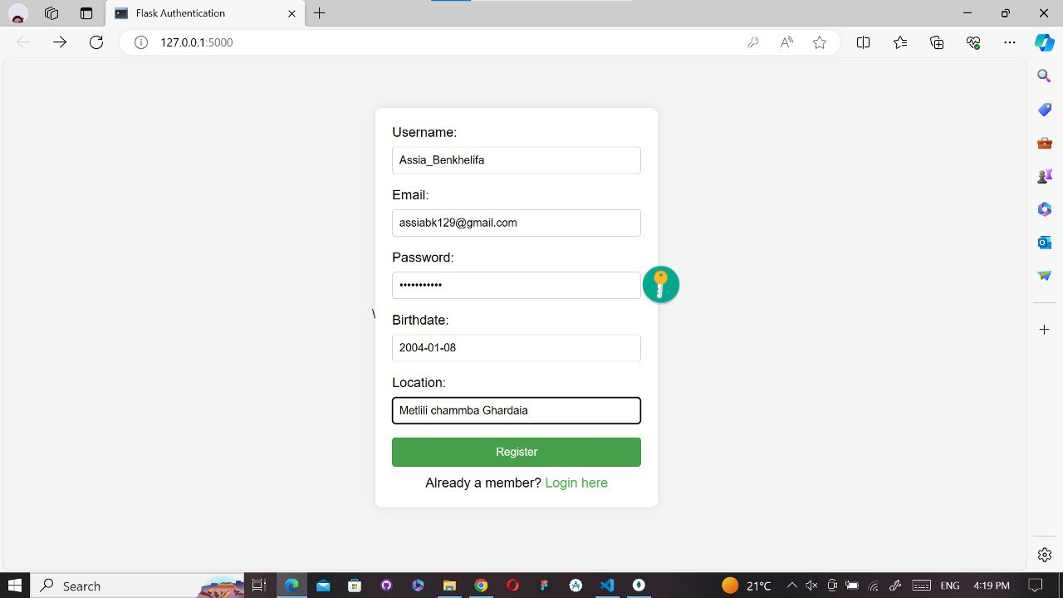
Now we will show the images of the database used

Slide 12

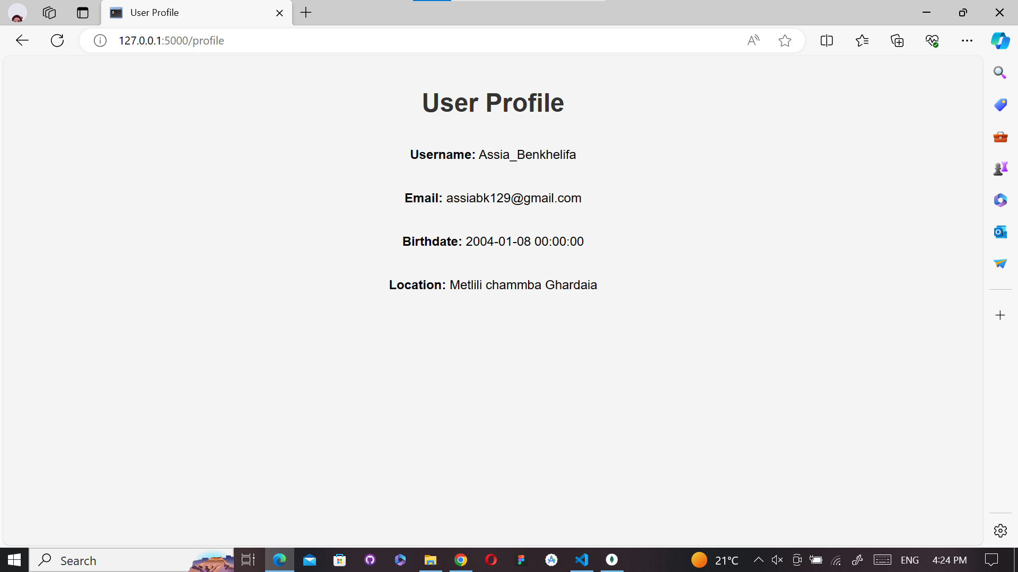

Slide 13
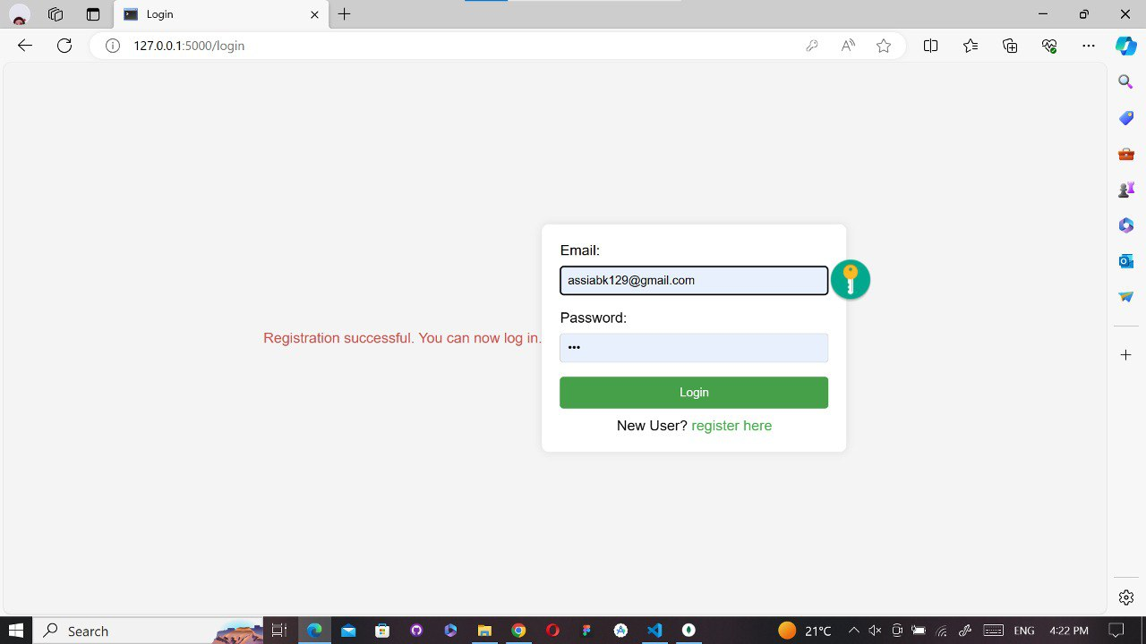

Slide 14
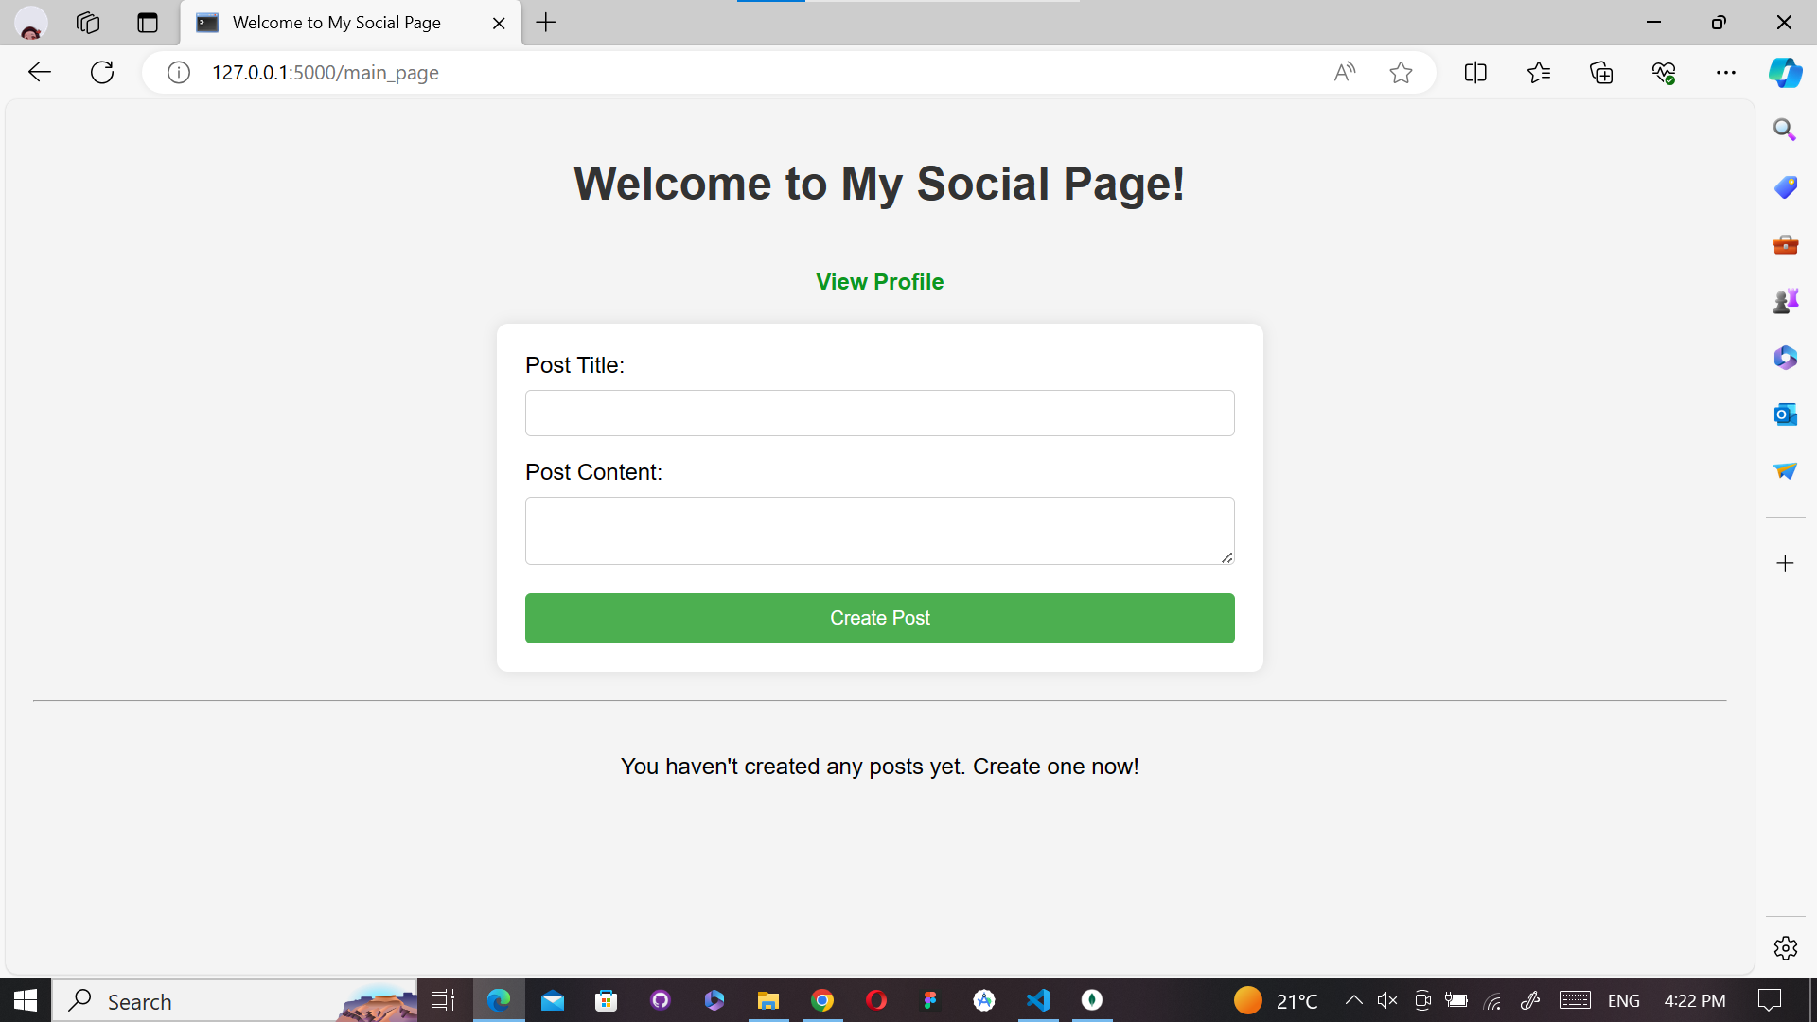

Slide 15
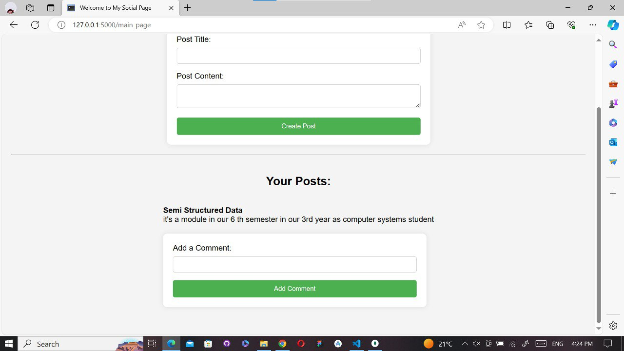

Slide 16
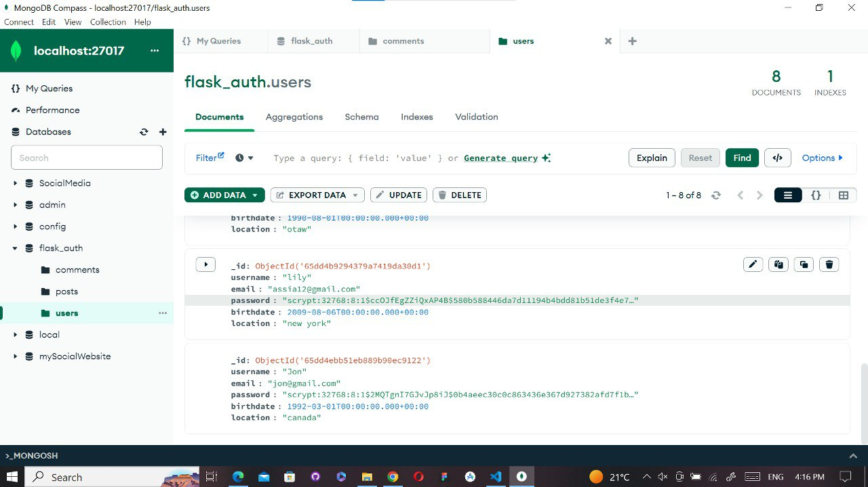

Slide 17
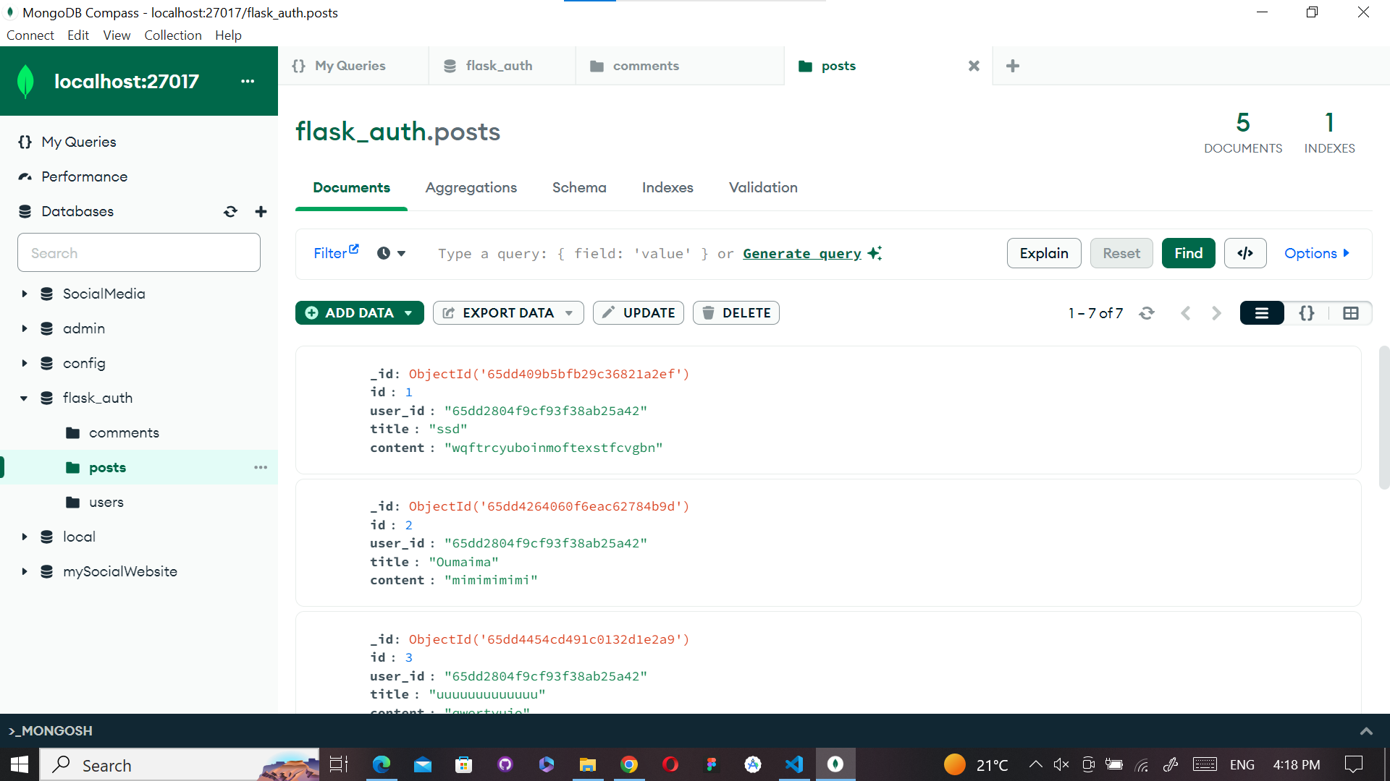

Slide 18
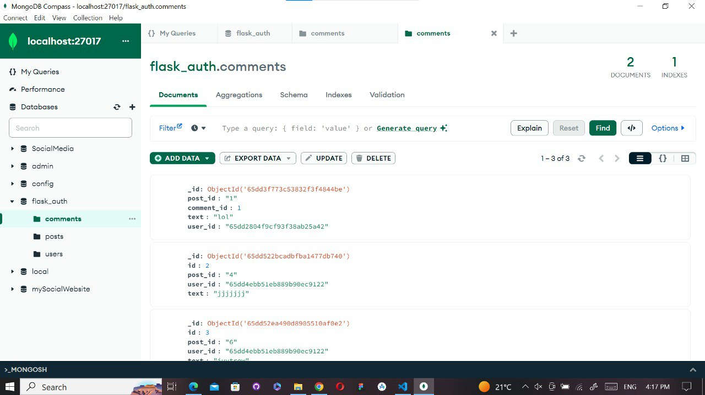

Slide 19
Conclusion
The implementation of a semi-structured social media database offers flexibility in content management and accommodates dynamic user interactions. MongoDB proves to be a suitable choice for managing such data structures, while the project's features enhance user experience and scalability.

Slide 20
Thank you for listening and watching

